Slide 1
Understanding the Scikit-Learn API
Introduction
Scikit-learn API essentials
Performing linear regression

Slide 2
Section 1: Introduction
Setting the scene
Scikit-learn models available
Scenario
Creating training data

Slide 3
Setting the Scene
This chapter works through an example of how to do supervised learning using scikit-learn
To reinforce your understanding of supervised learning
To help you understand how to use the scikit-learn API
Recall supervised learning:
You start with labelled training data, which allows you to create a model that relates features (inputs) to labels (results)
You can then use the model to predict results for real data
Scikit-learn has an elegant estimator API
Once you've learnt how to do one kind of modelling, it's a similar approach for other kinds of modelling

Slide 4
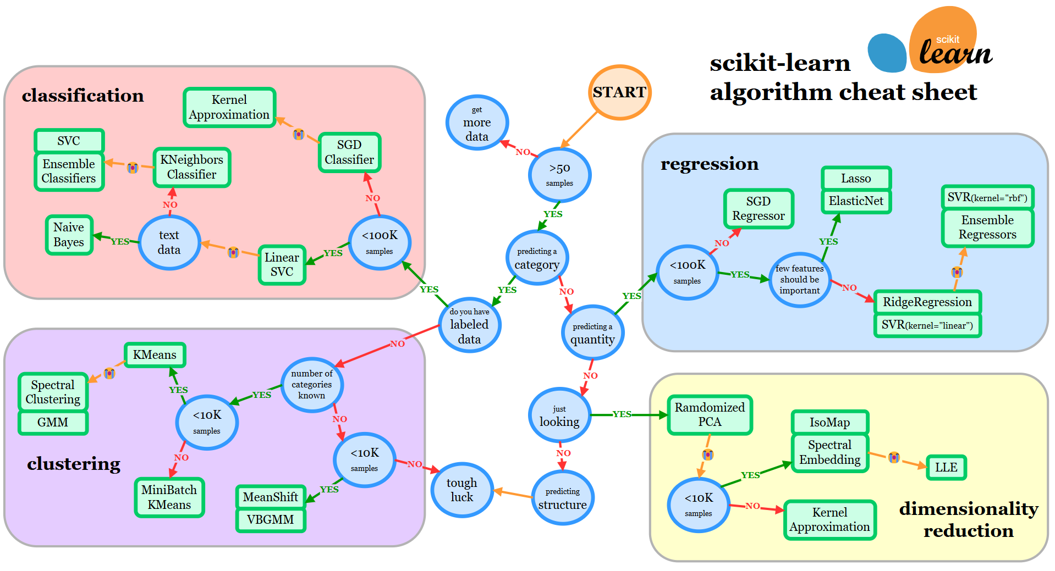
Scikit-Learn Models Available
Scikit-learn has a lot of models (estimator APIs) available
For guidance about which model to use when, see:
https://scikit-learn.org/stable/machine_learning_map.html

Slide 5
Scenario
We'll see how to do linear regression
This is an example of classification with continuous labels
We'll start with (x,y) training data and try to fit a line to the data
This will allow us to predict new results (for a given x, what is y?)
In machine learning terminology…
The feature matrix will be an [n_samples,n_features] matrix
Where n_features is 1 (i.e., the x value)
The target array will be an [n_samples] array
Where each value is the given/predicted label (i.e., the y value)

Slide 6
Creating Training Data (1 of 2)
The following code creates some simple training data and visualizes it as a scatterplot graph
x is a Python list of 50 random numbers, 0 - 10
y is a Python list of 50 numbers, calculated based on x values
import matplotlib.pyplot as plt
import numpy as np
import random
x = 10 * np.random.sample(50)
print(x)
y = [2 * ii - 5 + random.random() for ii in x]
print(y)
plt.scatter(x, y)
plt.show()
ex01-CreateData.py

Slide 7
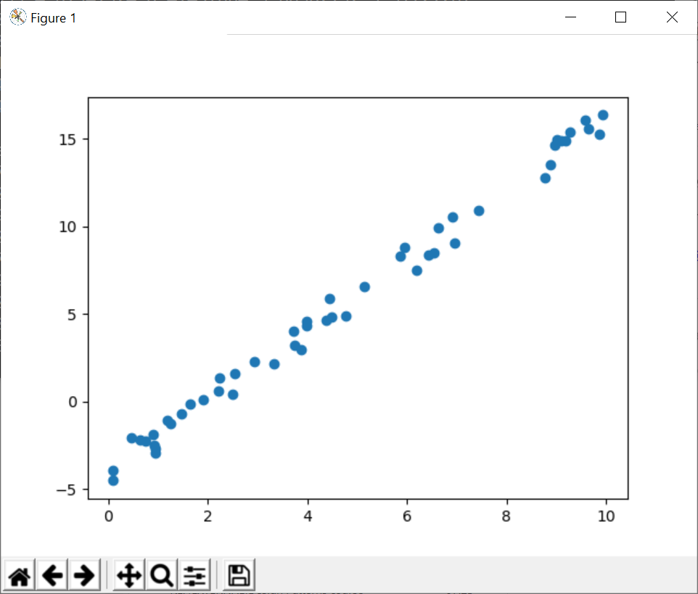
Creating Training Data (2 of 2)
Here's what the scatterplot graph looks like
There is clearly a linear relationship between (x, y) values
We'll use scikit-learn Linear Regression capabilities to fit the best line that shows the relationship between (x, y) values
This will enable us to predict y values for future x values

Slide 8
Section 2: Scikit-Learn API Essentials
Overview
Scikit-learn model classes
How to use the scikit-learn API

Slide 9
Overview
Machine learning is a wide subject
Lots of different types of modelling and algorithms available
For example:
Linear Regression
Naïve Bayes Classification
K-Means Clustering
Support Vector Machines
Decision Trees
Random Forests
Etc.

Slide 10
Scikit-Learn Model Classes
The scikit-learn API defines separate classes to implement the various types of machine learning models
The model classes are quite straightforward to use
Consistent interface API
Easily configurable via hyperparameters
Appropriate default hyperparameter values, to simplify usage
Support for numpy arrays and pandas DataFrames

Slide 11
How to use the Scikit-Learn API
To use scikit-learn to solve a machine learning problem, follow these general steps:
Choose which scikit-learn model class you want to use
Create an instance of the class, with suitable hyperparameters
Arrange your data into a features matrix (and target array?)
Fit the model to your data via the fit() method (with linear regression, the model will compute the line of best fit)
Use the model to predict labels for new data (e.g., for supervised learning, call the predict() method)

Slide 12
Section 3: Performing Linear Regression
Overview
Step 1: Choosing a scikit-learn model class
Step 2: Creating an instance of the model class
Step 3: Arranging data
Step 4: Fitting the model to the data
Step 5: Predicting labels for new data

Slide 13
Overview
In this example we'll see how to use scikit-learn to perform linear regression for our sample data
Scikit-learn will fit the best line that relates (x, y) values
We'll then use the model to predict y values for new x values

Slide 14
Step 1: Choosing a Scikit-Learn Model Class
Scikit-learn has a LinearRegression class
Deduces a line of best fit for a given feature matrix / target array
The following code imports the LinearRegression class
From the sklearn.linear_model Python module
from sklearn.linear_model import LinearRegression
ex02-DoLinearRegression.py

Slide 15
Step 2: Creating an Instance of the Model Class
On the previous slide we decided which scikit-learn model class to import
We must now create an instance of the model class, with suitable hyperparameters - here's the simplest example:
Alternatively, you can set hyperparameter values:
ex02-DoLinearRegression.py
model = LinearRegression()
model = LinearRegression(
fit_intercept = False, # Don't compute where graph cuts y axis.
copy_X = False, # Don't copy X data, i.e. allow overwriting.
n_jobs = None # Use all available processors.
)
See: https://scikit-learn.org/stable/modules/generated/sklearn.linear_model.LinearRegression.html

Slide 16
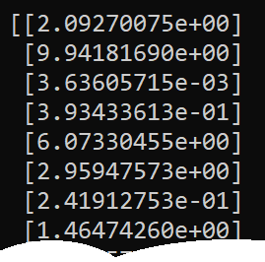
Step 3: Arranging Data
The scikit-learn model implementations require your data to be arranged into a features matrix (and target array?)
The features matrix must be a 2D array
At the moment, our features matrix is a 1D array
We can convert it to a 2D array as follows
This is what the data looks like now
The shape is [n_samples,1]
ex02-DoLinearRegression.py
X = x[:, np.newaxis]

Slide 17
Step 4: Fitting the Model to the Data (1 of 2)
This is the crucial step - it's where you pass your data into the scikit-learn model
To do all this, call fit() on your model
Pass in the feature matrix and the target array
What happens?
The model will perform an appropriate series of computations
E.g., a LinearRegression model computes the line of best fit
The results of the computation are available to you - see next slide
ex02-DoLinearRegression.py
model.fit(X, y)

Slide 18

Step 4: Fitting the Model to the Data (2 of 2)
When you call fit(), the model learns from the data that you have provided
The model exposes various parameters about the learnt data
These parameters have trailing underscores
Example:
Results:
coef_ is the slope of the line
intercept_ is where line cuts y axis
print("Model coef_ %f" % model.coef_)
print("Model intercept_ %f" % model.intercept_)
ex02-DoLinearRegression.py

Slide 19
Step 5: Predicting Labels for New Data (1 of 2)
Once you have trained your model, you can use the model to predict labels for new data
Call predict() on the model
Example:
Let's create some new random x values, and predict the y values
We'll also plot the predicted results in a scatterplot graph
xnew = 10 * np.random.sample(20)
Xnew = xnew[:, np.newaxis]
ynew = model.predict(Xnew)
plt.title("Predicted y values for new x values")
plt.scatter(xnew, ynew)
plt.plot(xnew, model.intercept_ + model.coef_ * xnew, color="orange", lw=1.5)
plt.show()
ex02-DoLinearRegression.py

Slide 20
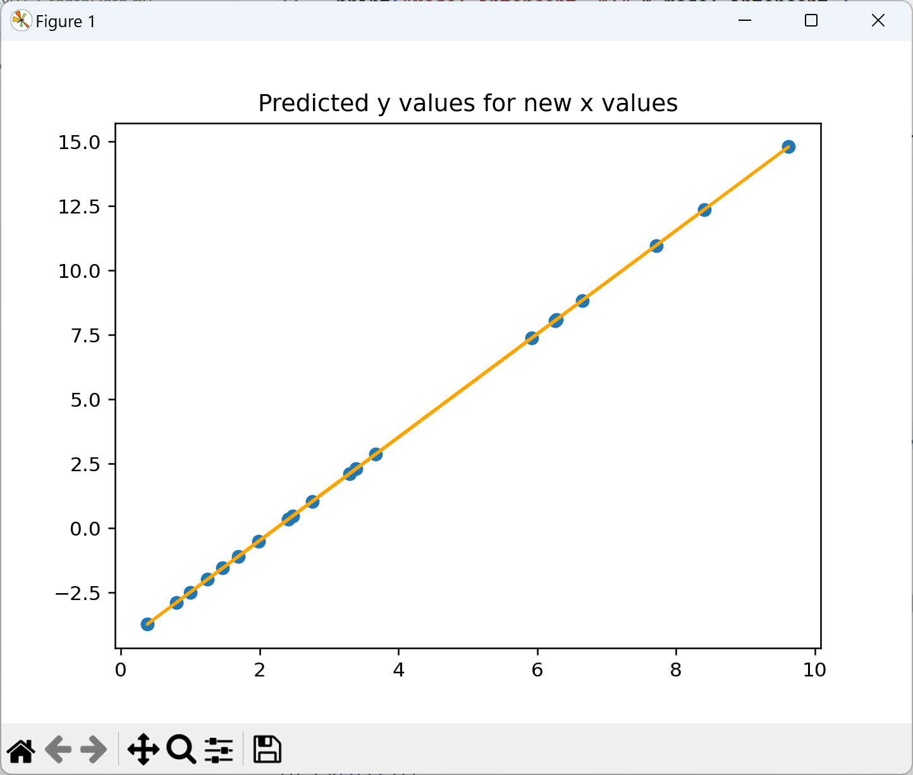
Step 5: Predicting Labels for New Data (2 of 2)
Here's the scatterplot diagram showing the predicted labels (i.e. y values) for new x values, using the line of best fit

Slide 21
Summary
Introduction
Scikit-learn API essentials
Performing linear regression

